Slide 1
Ruby on Rails
By Sam Jacobsen and Kyle Zoellner

Slide 2



Ruby on Rails and Why It is Useful
Framework centered mainly around back-end development
Fast development
Uses Ruby as its scripting language
Large, active community
Used by big companies such as GitHub, Fiverr, and Airbnb
Older framework; much documentation
Especially effective for databases
Uses Gems

Slide 3
Databases in Ruby on Rails
Rails is based around databases
Similarly to what we have done in this class, users can create a website on their localhost
No need for Ammps
Rails has support for SQLite out of the box
Can be changed later if need-be
Uses Active Records
A Gem that handles Database information
Makes handling and manipulating objects in a Database much easier

Slide 4
Gemfiles
What are Gems?
Ready-to-go modules that can be imported into a program
Can be found on https://rubygems.org/
At the time of making this, over 150,000,000,000 Gems have been downloaded
Can also install Gems via the command line
Gems install packages that they need to use
Installing one Gem can give the user many features
Allows the user to specify the Gem version they want to use
Avoids version conflicts

Slide 5
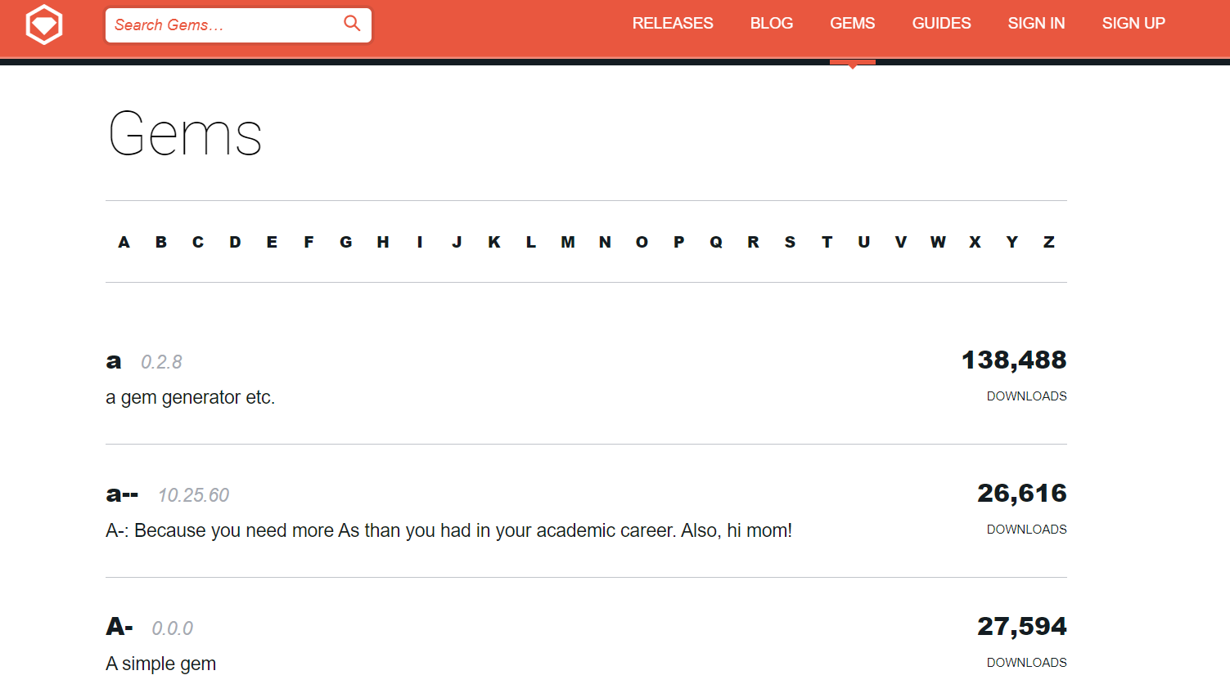
Find a Gem to Use

Slide 6
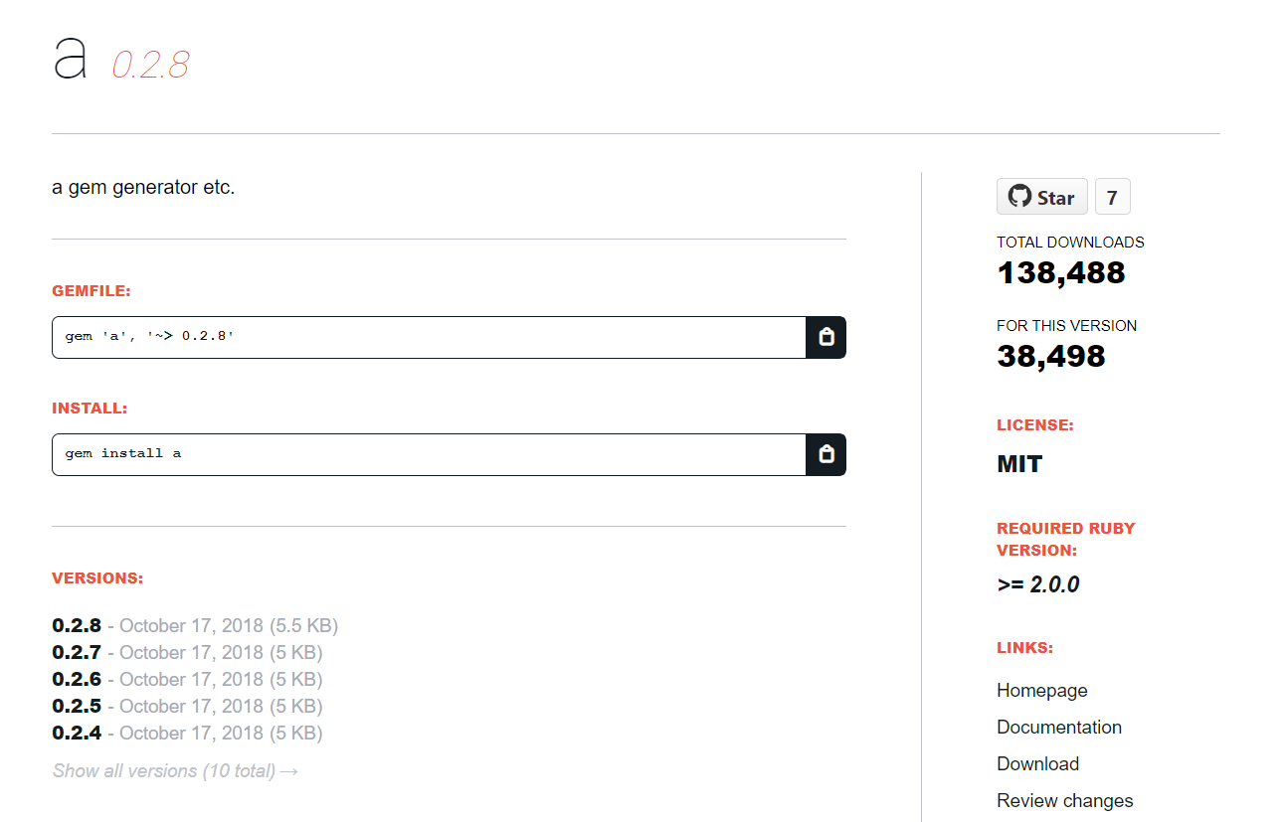
Add to the Gemfile and Install

Slide 7
Let’s move on to our demo

Slide 8
References
Ruby on Rails information: https://kinsta.com/blog/ruby-on-rails-vs-node-js/
Information about Gemfiles: https://www.youtube.com/watch?v=QDcf-Nga0Nw
Get Gems: https://rubygems.org/
Rails Database information: https://guides.rubyonrails.org/v2.3/getting_started.html#:~:text=Rails%20comes%20with%20built%2Din,can%20always%20change%20it%20later
Information about Active Records: https://www.theodinproject.com/lessons/ruby-on-rails-active-record-basics

